Slide 1
Unit 2: introduction to supervised Learning

Slide 2
Classification Problem
In machine learning, a classification problem is a type of supervised learning task where the objective is to predict the categorical class labels of new instances based on past observations.
Classification is the problem of identifying to which of a set of categories a new observation belongs, on the basis of a training set of data containing observations (instances) whose category membership is known.
Key Concepts
Supervised Learning: Classification falls under supervised learning because the algorithm learns from labeled training data. Each training example consists of an input feature set and the corresponding output class label.
Labels: These are the categories or classes the data points are assigned to. For example, in a binary classification problem, there might be two labels such as "spam" or "not spam."
Features: These are the input variables used to make the classification. In a spam email classifier, features might include the presence of certain keywords, the number of links, etc.

Slide 3
Types of Classification Problems
1.Binary Classification: The target variable has two possible classes. Examples include:
Spam detection: Spam vs. Not Spam
Medical diagnosis: Disease vs. No Disease
2. Multiclass Classification: The target variable has more than two classes. Examples include:
Handwritten digit recognition (0-9 digits)
Animal classification (cat, dog, bird, etc.)
3. Multilabel Classification: Each instance may belong to multiple classes simultaneously. Examples include:
Document tagging with multiple tags
Predicting the genres of a movie
Common Algorithms
1. Logistic Regression: Despite its name, it is used for binary classification problems.
2. Decision Trees: Models decisions with a tree-like structure.
3. Random Forest: An ensemble of decision trees.
4. Support Vector Machines (SVM): Finds the hyperplane that best separates different classes.

Slide 4

Consider the following data
Data in table is the training set of data. There are two attributes “Score1” and “Score2”. The class label is called “ Result”. The class labels has two possible values “Pass” and “Fail”. The data can be divided into two categories or classes: the set of data for which the class label is “Pass” and the set of data for which the class label is “Fail”.
If we have some new data, say “Score1=25” and “Score2=36”, what value should be assigned to “Result” corresponding to the new data in other words, to which of the two classes the new observation should be assigned?
To answer this question, using the given data alone we need to find the rule, or the formula, or the method that has been used in assigning the values to the class label “Result”. The problem of finding this rule or formula or the method is the classification problem.

Slide 5
Regression
A regression problem is the problem of determining a relation between one or more independent variables and an output variable which is a real continuous variable, given a set of observed values of the set of independent variables and the corresponding values of the output variable.
Linear Regression
Linear regression is a quiet and the simplest statistical regression technique used for predictive analysis in machine learning. Linear regression shows the linear relationship between the independent(predictor) variable i.e. X-axis and the dependent (output) variable i.e. Y-axis, called linear regression.
If there is a single input variable X (independent variable), such linear regression is simple linear regression.
A linear regression is used in statistics, economics, finance and more to analyze relationships between variables. For example predicting the stock market price, analyzing trends and sales estimates, salary forecasting, Real estate prediction etc..

Slide 6
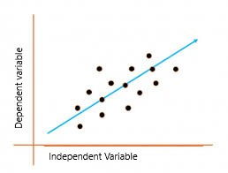
The graph above presents the linear relationship between the output(y) and predictor(X) variables. The blue line is referred to as the best-fit straight line. Based on the given data points, we attempt to plot a line that fits the points the best.
Simple Regression Calculation
To calculate best-fit line linear regression uses a traditional slope-intercept form which is given below,
Y i = β 0 + β 1 X i
where Y i = Dependent variable, β 0 = constant/Intercept, β 1 = Slope/Intercept, X i = Independent variable.
Xmxm

Slide 7
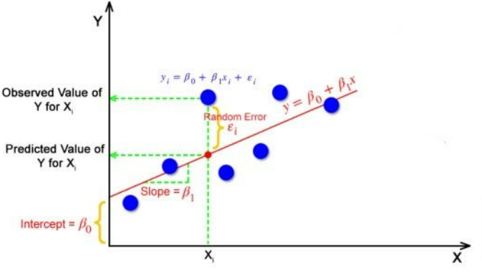
This algorithm explains the linear relationship between the dependent(output) variable y and the independent(predictor) variable X using a straight line Y= B 0 + B 1 X.
But how does the linear regression find out which is the best-fit line?
The goal of the linear regression algorithm is to get the best values for B 0 and B 1 to find the best-fit line. The best-fit line is a line that has the least error which means the error between predicted values and actual values should be minimum.

Slide 8
Random Error(Residuals)
In regression, the difference between the observed value of the dependent variable(y i ) and the predicted value(predicted) is called the residuals.
ε i = y predicted – y i
where y predicted = B 0 + B 1 X I
What is the Best Fit Line?
In simple terms, the best-fit line is a line that best fits the given scatter plot. Mathematically, you obtain the best-fit line by minimizing the Residual Sum of Squares (RSS).
The reason behind squaring the error/residuals
1. If we are not squaring the error, the negative and positive signs will cancel. We will end up with error = 0.

Slide 9

Cost Function for Linear Regression
The cost function helps to work out the optimal values for B 0 and B 1 , which provides the best-fit line for the data points.
In Linear Regression, generally Mean Squared Error (MSE) cost function is used, which is the average squared error that occurred between the y predicted and y i.
We calculate MSE using the simple linear equation y=mx+b:
Using the MSE function, we’ll update the values of B 0 and B 1 such that the MSE value settles at the minima. These parameters can be determined using the gradient descent method such that the value for the cost function is minimum.

Slide 10
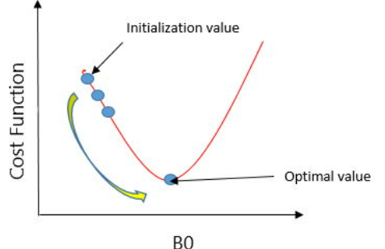
Gradient Descent for Linear Regression
Gradient Descent is one of the optimization algorithms that optimize the cost function (objective function) to reach the optimal minimal solution. To find the optimum solution, we need to reduce the cost function (MSE) for all data points. This is done by updating the values of the slope coefficient (B1) and the constant coefficient (B0) iteratively until we get an optimal solution for the linear function.
A regression model optimizes the gradient descent algorithm to update the coefficients of the line by reducing the cost function by randomly selecting coefficient values and then iteratively updating the coefficient values to reach the minimum cost function.

Slide 11
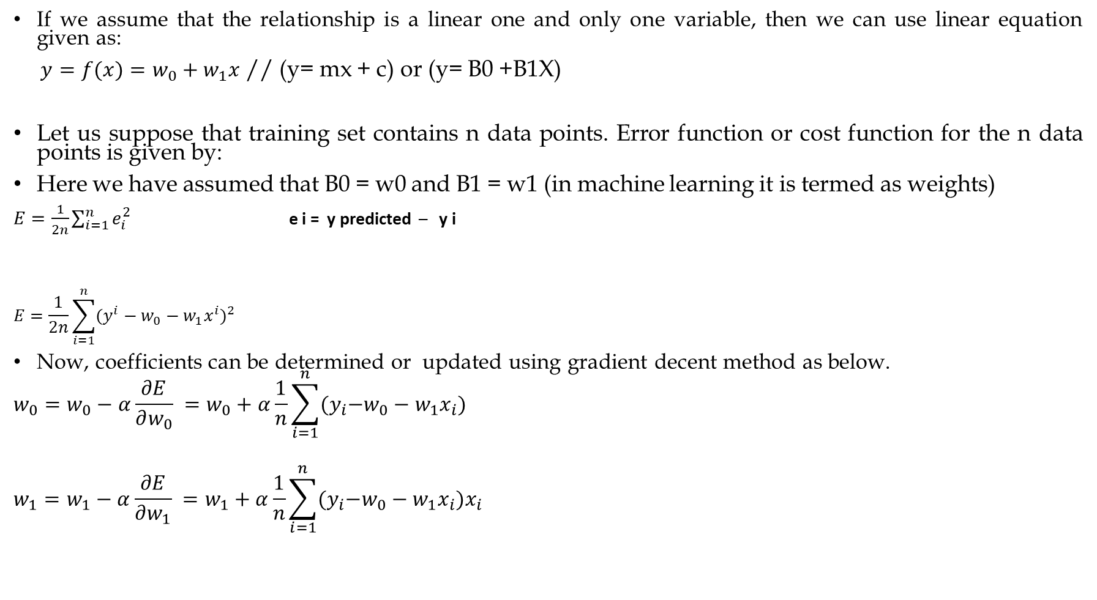
If we assume that the relationship is a linear one and only one variable, then we can use linear equation given as:
$y=f(x)=w_{0}+w_{1}x$ // (y= mx + c) or (y= B0 +B1X)
Let us suppose that training set contains n data points. Error function or cost function for the n data points is given by:
Here we have assumed that B0 = w0 and B1 = w1 (in machine learning it is termed as weights)
$E=\frac{1}{2n}\sum_{i=1}^{n}{e_{i}^{2}}$ e i = y predicted – y i
$$E=\frac{1}{2n}\sum_{i=1}^{n}{{(y^{i}−w_{0}−w_{1}x^{i})}^{2}}$$
Now, coefficients can be determined or updated using gradient decent method as below.
$$w_{0}=w_{0}−α\frac{∂E}{∂w_{0}} =w_{0}+α\frac{1}{n}\sum_{i=1}^{n}{{{(y}_{i}−w}_{0}−w_{1}x_{i}})$$
$$w_{1}=w_{1}−α\frac{∂E}{∂w_{1}} =w_{1}+α\frac{1}{n}\sum_{i=1}^{n}{{{(y}_{i}−w}_{0}−w_{1}x_{i}})x_{i}$$

Slide 12
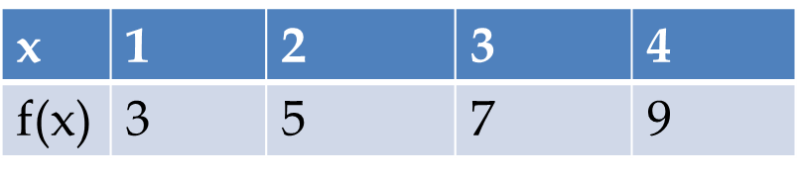
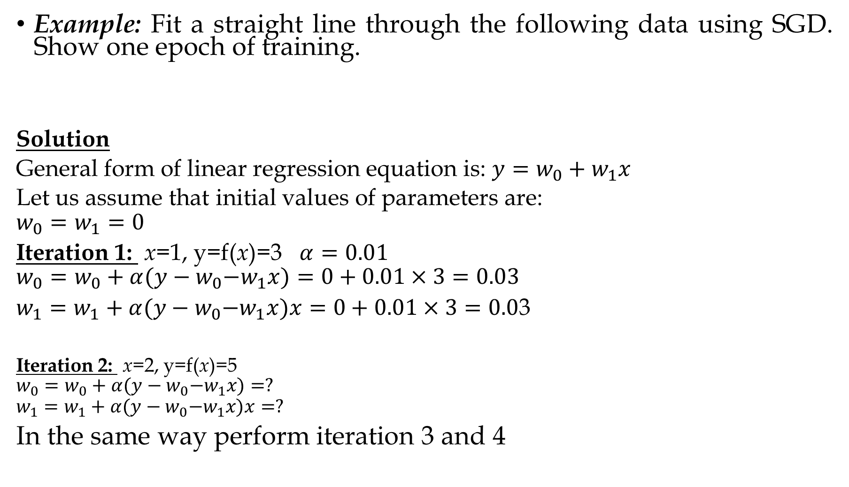
Example: Fit a straight line through the following data using SGD. Show one epoch of training.
Solution
General form of linear regression equation is: $y=w_{0}+w_{1}x$
Let us assume that initial values of parameters are:
$$w_{0}=w_{1}=0$$
Iteration 1: x=1, y=f(x)=3 $α=0.01$
$$w_{0}=w_{0}+α{(y−w}_{0}−w_{1}x)=0+0.01×3=0.03$$
$w_{1}=w_{1}+α{(y−w}_{0}−w_{1}x)x=0+0.01×3=0.0$3
Iteration 2: x=2, y=f(x)=5
$$w_{0}=w_{0}+α{(y−w}_{0}−w_{1}x)=?$$
$$w_{1}=w_{1}+α{(y−w}_{0}−w_{1}x)x=?$$
In the same way perform iteration 3 and 4

Slide 13
Evaluation Metrics for Linear Regression
The strength of any linear regression model can be assessed using various evaluation metrics. These evaluation metrics usually provide a measure of how well the observed outputs are being generated by the model.
Mean Squared Error (MSE)
MSE is a simple metric that calculates the difference between the actual value and the predicted value (error), squares it and then provides the mean of all the errors.
Where y is actual value and is predicted value

Slide 14
Root Mean Squared Error (RMSE)
RMSE is the root of MSE and is beneficial because it helps to bring down the scale of the errors closer to the actual values, making it more interpretable.
Mean Absolute Error or MAE
MAE is the mean of the absolute error values (actuals – predictions).
If one wants to ignore the outlier values to a certain degree, MAE is the choice since it reduces the penalty of the outliers significantly with the removal of the square terms.

Slide 15

Coefficient of Determination or R-squared (R²)
R- Squared is a number that explains the amount of variation that is explained/captured by the developed model. It always ranges between 0 and 1. overall, the higher the value of R-Squared, the better the model fits the data.
Mathematically it can be represented as,
R² = 1- (RSS/TSS)
Residual sum of Squares (RSS) is defined as the sum of the residual for each data point in the plot/data. It is the measure of the difference between the expected and the actual observed output.

Slide 16

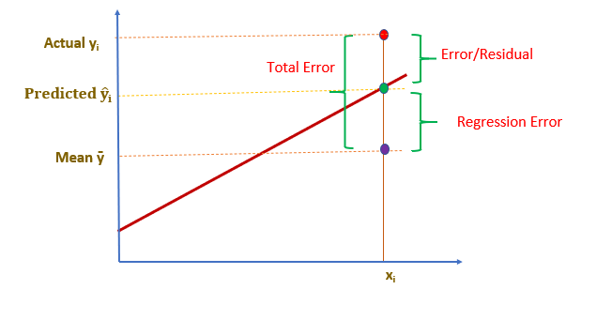
Total Sum of Squares (TSS) is defined as the sum of errors of the data points from the mean of the response variable. Mathematically
Where y hat is the mean of the sample data points.

Slide 17
Perceptron
The perceptron is the simplest form of a neural network used for the classifying linearly separable patterns. Patterns that lie on opposite sides of a hyperplane are called linearly separable patterns.
Basically, perceptron consists of a single neuron with adjustable synaptic weights and bias. The algorithm used to adjust the free parameters of this neural network first appeared in a learning procedure developed by Rosenblatt (1958, 1962).
Rosenblatt’s perceptron is built around the McCulloch–Pitts model of a neuron.
The summing node of the neural model computes a linear combination of the input. The resulting sum is applied to a hard limit activation function.
The neuron produces an output equal to 1 if the hard limiter input is positive, and -1 if it is negative.

Slide 18
perceptron
The hard limiter input (or induced local field) of the neuron is.

Slide 19
Decision Tree Representation
Decision Tree is a supervised learning algorithm which can be used for solving both classification and regression problems.
It can solve problems for both categorical and numerical data
Decision Tree regression builds a tree-like structure in which each internal node represents the "test" for an attribute, each branch represent the result of the test, and each leaf node represents the final decision or result.
A decision tree is constructed starting from the root node/parent node (dataset), which splits into left and right child nodes (subsets of dataset). These child nodes are further divided into their children node, and themselves become the parent node of those nodes. Consider the below image:

Slide 20
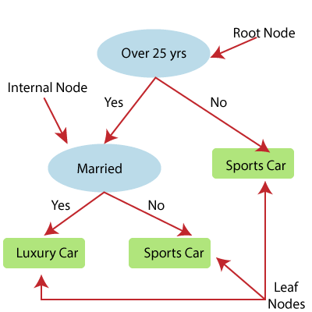
Above image showing the example of Decision Tee regression, here, the model is trying to predict the choice of a person between Sports cars or Luxury car.

Slide 21
Decision Tree Classification Algorithm
In a Decision tree, there are two nodes, which are the Decision Node and Leaf Node. Decision nodes are used to make any decision and have multiple branches, whereas Leaf nodes are the output of those decisions and do not contain any further branches.
The decisions or the test are performed on the basis of features of the given dataset.
It is a graphical representation for getting all the possible solutions to a problem/decision based on given conditions.
It is called a decision tree because, similar to a tree, it starts with the root node, which expands on further branches and constructs a tree-like structure.
A decision tree simply asks a question, and based on the answer (Yes/No), it further split the tree into subtrees.
Below diagram explains the general structure of a decision tree:

Slide 22


Slide 23
Decision Tree Terminologies
Root Node: Root node is from where the decision tree starts. It represents the entire dataset, which further gets divided into two or more homogeneous sets.
Leaf Node: Leaf nodes are the final output node, and the tree cannot be segregated further after getting a leaf node.
Splitting: Splitting is the process of dividing the decision node/root node into sub-nodes according to the given conditions.
Branch/Sub Tree: A tree formed by splitting the tree.
Pruning: Pruning is the process of removing the unwanted branches from the tree.
Parent/Child node: The root node of the tree is called the parent node, and other nodes are called the child nodes.

Slide 24
How does the Decision Tree algorithm Work?
In a decision tree, for predicting the class of the given dataset, the algorithm starts from the root node of the tree. This algorithm compares the values of root attribute with the record (real dataset) attribute and, based on the comparison, follows the branch and jumps to the next node.
For the next node, the algorithm again compares the attribute value with the other sub-nodes and move further. It continues the process until it reaches the leaf node of the tree. The complete process can be better understood using the below algorithm:
Step-1: Begin the tree with the root node, says S, which contains the complete dataset.
Step-2: Find the best attribute in the dataset using Attribute Selection Measure (ASM).
Step-3: Divide the S into subsets that contains possible values for the best attributes.
Step-4: Generate the decision tree node, which contains the best attribute.
Step-5: Recursively make new decision trees using the subsets of the dataset created in step -3. Continue this process until a stage is reached where you cannot further classify the nodes and called the final node as a leaf node.

Slide 25
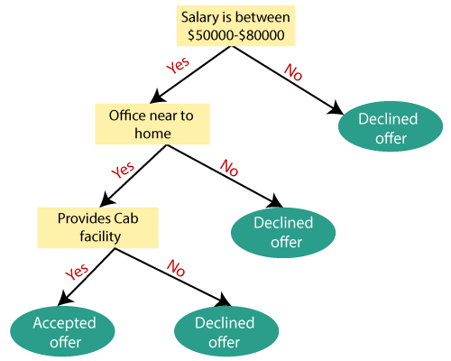
Example: Suppose there is a candidate who has a job offer and wants to decide whether he should accept the offer or Not. So, to solve this problem, the decision tree starts with the root node (Salary attribute by ASM). The root node splits further into the next decision node (distance from the office) and one leaf node based on the corresponding labels. The next decision node further gets split into one decision node (Cab facility) and one leaf node. Finally, the decision node splits into two leaf nodes (Accepted offers and Declined offer). Consider the below diagram:

Slide 26
Attribute Selection measures
While implementing a Decision tree, the main issue arises that how to select the best attribute for the root node and for sub-nodes. So, to solve such problems there is a technique which is called as Attribute selection measure or ASM. By this measurement, we can easily select the best attribute for the nodes of the tree. There are two popular techniques for ASM, which are:
Information Gain
Gini index
1. Information Gain:
Information gain is the measurement of changes in entropy after the segmentation of a dataset based on an attribute.
It calculates how much information a feature provides us about a class.
According to the value of information gain, we split the node and build the decision tree.
A decision tree algorithm always tries to maximize the value of information gain, and a node/attribute having the highest information gain is split first. It can be calculated using the below

Slide 27
Let S be a set of examples, A be a feature (or, an attribute), Sv be the subset of S with A=v, and Values (A) be the set of all possible values of A. Then the information gain of an attribute A relative to the set S, denoted by Gain (S, A), is defined as
Where s denotes the number of elements in S.
Entropy
Entropy is a metric to measure the impurity in a given attribute. It specifies randomness in data. Entropy can be calculated as:

Slide 28
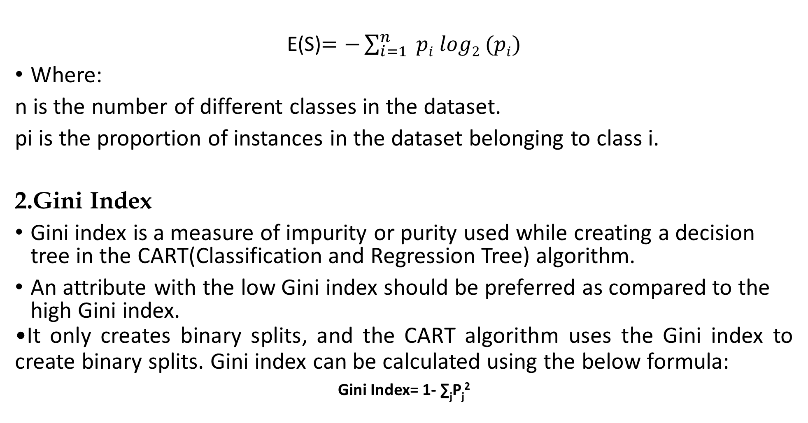
E(S)$=−\sum_{i=1}^{n}{ pi log2 (pi)}$
Where:
n is the number of different classes in the dataset.
pi​ is the proportion of instances in the dataset belonging to class i.
2.Gini Index
Gini index is a measure of impurity or purity used while creating a decision tree in the CART(Classification and Regression Tree) algorithm.
An attribute with the low Gini index should be preferred as compared to the high Gini index.
It only creates binary splits, and the CART algorithm uses the Gini index to create binary splits. Gini index can be calculated using the below formula:
Gini Index= 1- ∑_{j}P_{j}²

Slide 29
ID3 (iterative Dichotomiser 3):
The algorithms uses information gain to select the most useful attribute for classification.
We assume that there are only two class labels, namely, “+” and “-”. The examples with class labels “+” are called positive examples and others negative examples.

Slide 30
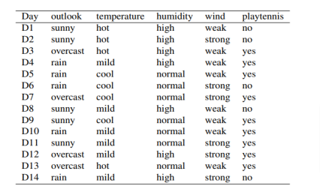
Example: Use ID3 algorithm to construct a decision tree for the data in Table

Slide 31
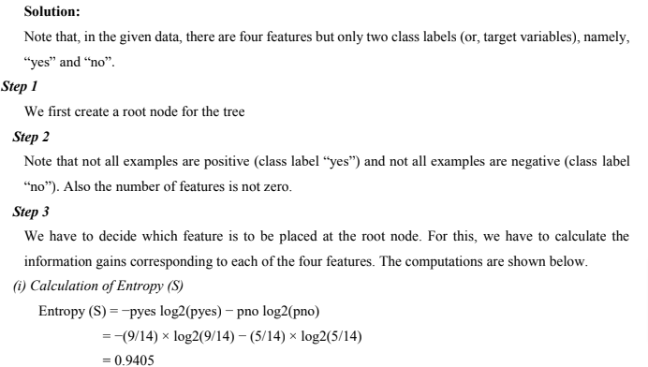
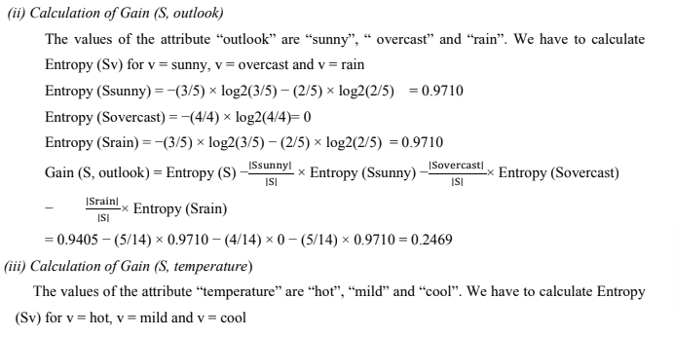

Slide 32
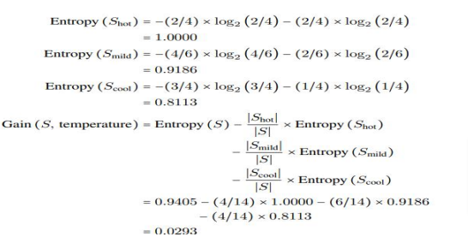
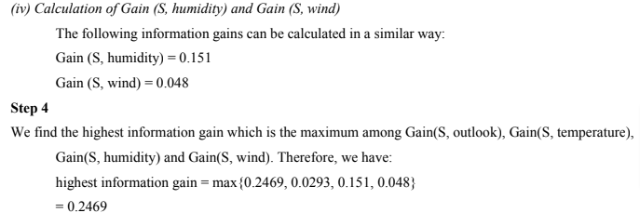

Slide 33
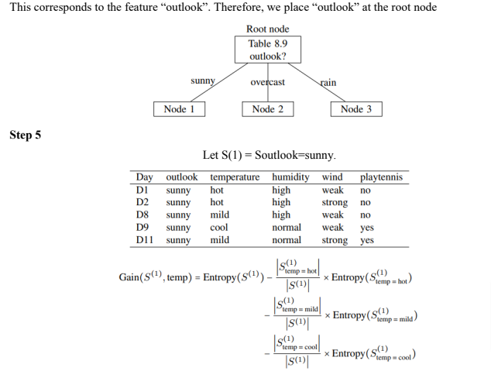

Slide 34
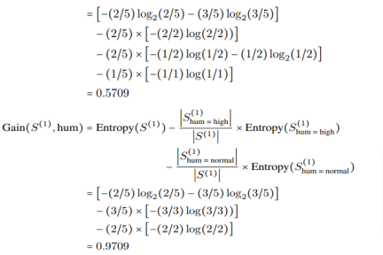
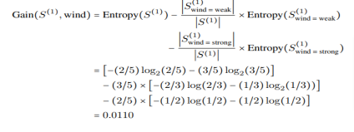

Slide 35
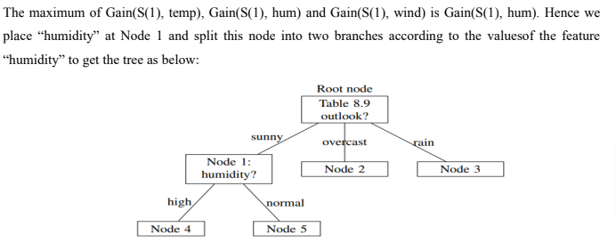
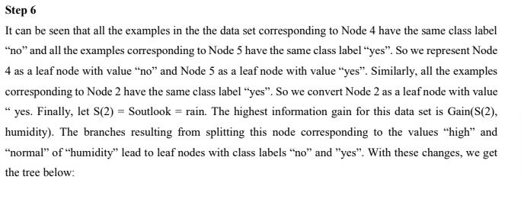

Slide 36
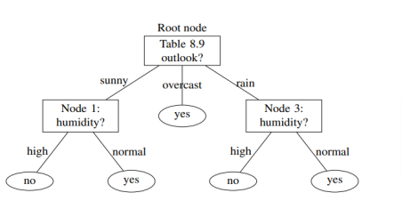

Slide 37
Support Vector Machine
Support Vector Machine or SVM is one of the most popular Supervised Learning algorithms, which is used for Classification as well as Regression problems.
However, primarily, it is used for Classification problems in Machine Learning.
A support vector machine takes input data points and outputs the hyperplane (which in two dimensions it’s simply a line) that best separates the data points into two classes.

Slide 38
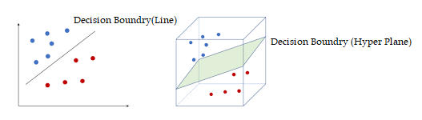
Support Vector Machine
This line or hyperplane is the decision boundary: any data points that falls to one side of it is classified in one class and, and the data points that falls to the other of it is classified in another class.

Slide 39
Support Vector Machine
Compared to newer algorithms like neural networks, they have two main advantages: higher speed and better performance with a limited number of samples (in the thousands).
Support vectors are data points that are closest to the hyperplane and influence the position and orientation of the hyperplane.
To separate the two classes of data points, there are many possible hyperplanes that could be chosen. SVM algorithm selects optimal hyperplane by choosing hyperplane with largest margin. Such hyperplane is called maximum marginal hyperplane (MMH).
Let H1 and H2 are planes that passes through support vectors and parallel to the hyperplane of decision boundary.

Slide 40
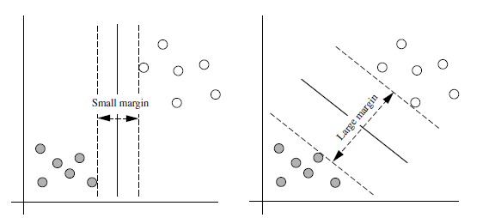
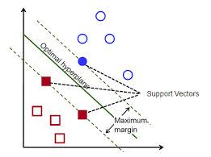
Support Vector Machine
Distance between plane H1 and the hyperplane should be equal to distance between plane H2 and the hyperplane. Margin is the distance between planes H1 and H2.

Slide 41
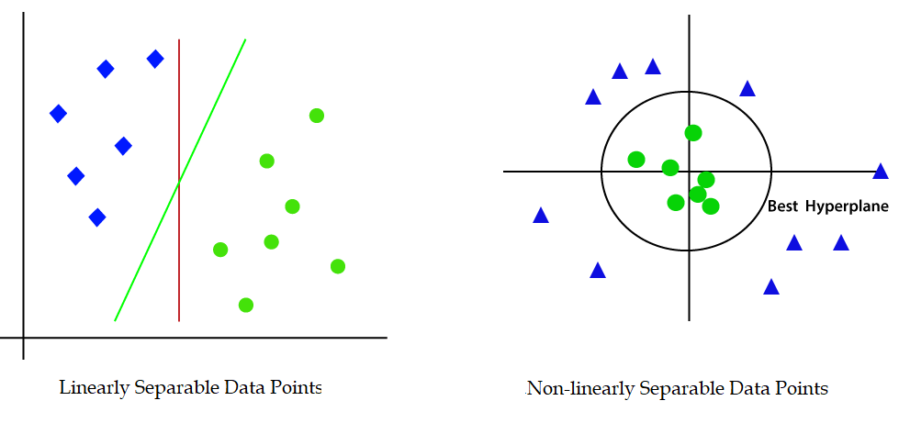
Support Vector Machine
Support Vector Machine(SVM) can be of two types: Linear SVM and Non-linear SVM.
SVM that is used to classify linearly separable data points is called linear SVM whereas the SVM that is used to classify non-linearly separable data points is called non-linear SVM.

Slide 42
Support Vector Machine
Non-linear SVM works in following two steps:
It transforms low–dimensional data points into high-dimensional data points, that are linearly separable, by using kernel-trick.
Then, it classifies data points using linear-hyperplane.
SVM algorithms use a set of mathematical functions that are defined as the kernel.
These functions are used to transform non-linearly separable low-dimensional data points into linearly separable high-dimensional data points.
Popular kernels are: Linear Kernel, Polynomial Kernel, Gaussian Kernel, Radial Basis Function (RBF), Sigmoid Kernel, etc.

Slide 43
Maximal Margin Hyperplanes
Consider a linearly separable data set having two class labels “-1” and “+1”. Consider a separating hyperplane H for the data set.
Consider the perpendicular distances from the training instances to the separating hyperplane H and consider the smallest such perpendicular distance. The double of this smallest distance is called margin of the separating hyperplane H.
The hyperplane for which the margin is the largest is called the maximal margin hyperplane (also called maximum margin hyperplane) or the optimal separating hyperplane.
The maximal margin hyperplane is also called the support vector machine for the data set.
The data points that lie closest to the maximal margin hyperplane are called the support vectors.

Slide 44
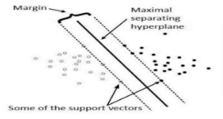

Slide 45
Finding maximal margin
Finding the maximum margin in a Support Vector Machine (SVM) involves training the SVM model to optimize the margin while correctly classifying the data points.
Key concepts
Hyperplane: Imagine you have a bunch of points on a plane, and you want to draw a line that separates points of different classes (like red points and blue points). In higher dimensions, this line becomes a "hyperplane.“
Margin: The margin is the gap between this separating line and the closest points from each class. The idea is to make this gap as wide as possible.
Support Vectors: These are the closest points to the hyperplane from each class. They "support" the position of the hyperplane.

Slide 46
The Goal
The goal of an SVM is to find the hyperplane that maximizes the margin between different classes. By maximizing this margin, the SVM aims to improve the classifier's performance on new, unseen data.
Steps in Simple Terms
Drawing the Line (Hyperplane):
Imagine you have two sets of points in a 2D space. You want to draw a straight line between them that separates them as clearly as possible.
2. Finding the Best Line:
To find the best line, you try different lines and measure how wide the margin is for each line.
The best line is the one that has the widest margin.
3. Mathematical Optimization:
Instead of trying every possible line, we use math to calculate the best one. This involves setting up an optimization problem where we maximize the margin.
The math ensures that the line not only separates the points but also does so with the maximum possible margin.

Slide 47
Support Vector Machine
Example
Consider following data points:
Positively Labelled Data Points:(3,1),(3,-1),(6,1),(6,-1)
Negatively Labelled Data Points:(1,0),(0,1),(0,-1),(-1,0)
Determine the equation of hyperplane that divides the above data points into two classes.
Then predict the class of data point (5,2).

Slide 48
Support Vector Machine
Solution
Support vectors are
s1=(1,0), s2=(3,1), s3=(3,-1) why???
Augment support vectors with b=1
s1=(1,0,1), s2=(3,1,1), s3=(3,-1,1)

Slide 49
Support Vector Machine
Solution
Since there are three support vectors, we need to calculate three variables
Thus, three linear equations can be written as:
After simplifying above equations, we get

Slide 50
Solution
After simplifying above equations, we get
Solving these equations, we get
Now, we can compute weight vector of hyperplane as below

Slide 51
Solution
Thus,
Hence, equation of hyper plane that divides data points is
x-2=0 How?
Data point to be classified is (5,2)
Putting this data point is above equation we get,
5-2=3
Thus the data point (5,2) belongs to +1 (Positively) class

